Slide 1
Multimedia Systems Lecture – 16
By
Dr. Priyambada Subudhi
Assistant Professor
IIIT Sri City

Slide 2
3D Movie Using Colored Glasses
In the early days, most movie theaters offering a 3D experience provided glasses tinted with complementary colors, usually red on the left and cyan on the right. This technique is called Anaglyph 3D.
Anaglyph 3D images contain two differently filtered colored images, one for each eye. The left image is filtered to remove Blue and Green, and the right image is filtered to remove Red.
When viewed through the "color-coded" "anaglyph glasses", each of the two images reaches the eye it's intended for, revealing an integrated stereoscopic image.
The visual cortex of the brain fuses this into the perception of a three-dimensional scene or composition.
The Anaglyph 3D movies are easy to produce. However, due to the color filtering, the color quality is not necessarily the best.

Slide 3
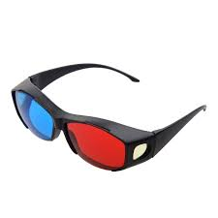
Anaglyph 3d glasses

Slide 4
3D Movies Using Circularly Polarized Glasses
Nowadays, the dominant technology in 3D movie theaters is the RealD Cinema System.
Movie-goers are required to wear polarized glasses in order to see the movie in 3D.
Basically, the lights from the left and right pictures are polarized in different directions. They are projected and superimposed on the same screen.
The left and right polarized glasses that the audience wear are polarized accordingly, which allows one of the two polarized pictures to pass through while blocking the other.
Circularly polarized glasses are used so the users can tilt their heads and look around a bit more freely without losing the 3D percept.

Slide 5
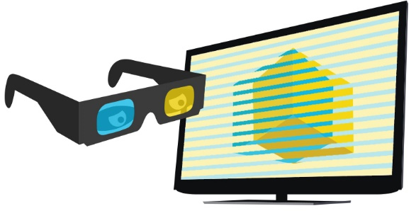
Polarized 3D systems

Slide 6
3D TV with Shutter Glasses
Most TVs for home entertainment, however, use Shutter Glasses.
Basically, the liquid crystal layer on the glasses that the user wears becomes opaque (behaving like a shutter) when some voltage is applied. It is otherwise transparent.
The glasses are actively (e.g., via Infra-Red) synchronized with the TV set that alternately shows left and right images (e.g., 120Hz for the left and 120Hz for the Right) in a Time Sequential manner.
3D vision with shutter glasses can readily be realized on desktop computers or laptops with a modest addition of specially designed hardware and software. The NVIDIA GeForce 3D Vision Kit is such an example.

Slide 7
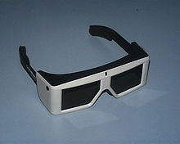
A pair of Crystal Eyes shutter glasses

Slide 8
Audio
Audio information is crucial for multimedia presentations and, in a sense, is the simplest type of multimedia data.
However, some important differences between audio and image information cannot be ignored. For example, while it is customary and useful to occasionally drop a video frame from a video stream, to facilitate viewing speed, we simply cannot do the same with sound information or all sense will be lost from that dimension.

Slide 9
Digitization of Sound
What is Sound?
Sound is a wave phenomenon like light, but it is macroscopic and involves molecules of air being compressed and expanded under the action of some physical device.
For example, a speaker in an audio system vibrates back and forth and produces a longitudinal pressure wave that we perceive as sound.
Without air there is no sound—for example, in space.
Since sound is a pressure wave, it takes on continuous values, as opposed to digitized ones with a finite range.
Nevertheless, if we wish to use a digital version of sound waves, we must form digitized representations of audio information.

Slide 10
Although such pressure waves are longitudinal, they still have ordinary wave properties and behaviors, such as reflection (bouncing), refraction (change of angle when entering a medium with a different density), and diffraction (bending around an obstacle). This makes the design of “surround sound” possible.
In general, any signal can be decomposed into a sum of sinusoids, if we are willing to use enough sinusoids.
A weighted sinusoids can build up quite a complex signal.

Slide 11
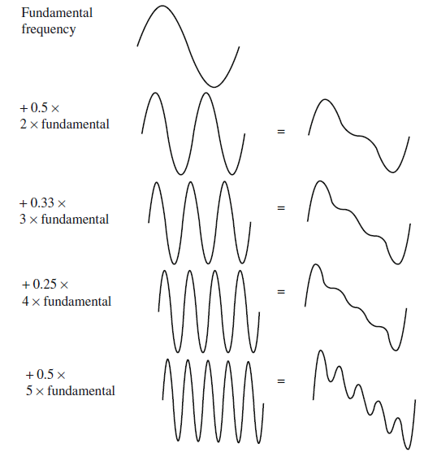
Building up a complex signal by superposing sinusoids

